Slide 1


Spring 2021
SKKU Biostats and Big data
CHOONG-WAN WOO | COCOAN lab | http://cocoanlab.github.io

Slide 2
GBME Probability and Statistics
Lecture 14
Lecture 14
Sampling distribution and
Central limit theorem
CHOONG-WAN WOO | COCOAN lab | http://cocoanlab.github.io

Slide 3
Lecture 14
Statistical inference
The goals of statistical inference:
How to draw conclusions about a population using only a subset of the population
How to estimate population parameters and quantify the amount of confidence we can place in them
How to use this information to make decisions/conclusions
Notation:
Population - Entire group of items/individuals we want information about
Sample - The part of the population we actually examine in order to gather information
A parameter is a number that describes the population.
A statistic is a number that describes a sample.
CHOONG-WAN WOO | COCOAN lab | http://cocoanlab.github.io

Slide 4
Lecture 14
Quiz 14-1 (2 min)
https://forms.gle/CnHDpUp4YmzgeDwaA
CHOONG-WAN WOO | COCOAN lab | http://cocoanlab.github.io

Slide 5
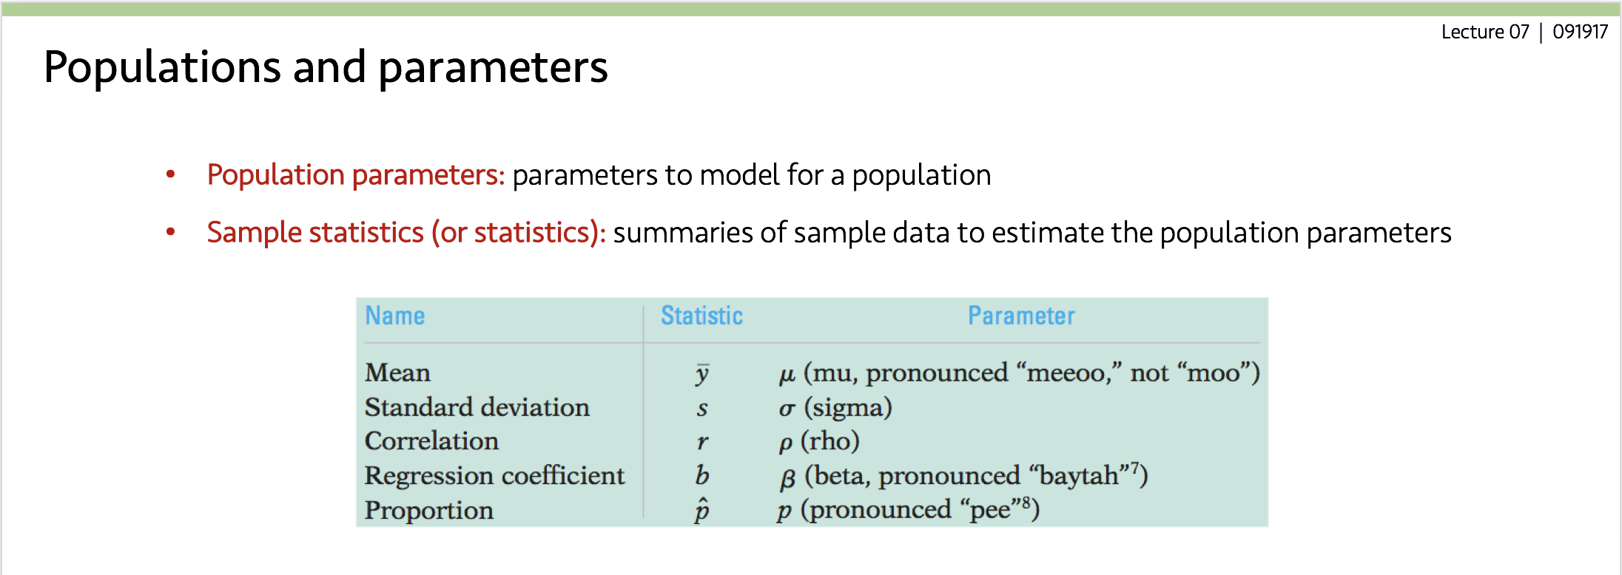
Lecture 14
Statistical inference
Parameter and statistic
A parameter is a fixed number, but we do not know its actual value.
The value of a statistic is known after we take a sample, but it can vary from sample to sample.
We often use a statistic to estimate an unknown population parameter.
CHOONG-WAN WOO | COCOAN lab | http://cocoanlab.github.io

Slide 6
Lecture 14
Statistical inference
Parameter and statistic
A parameter is a fixed number, but we do not know its actual value.
The value of a statistic is known after we take a sample, but it can vary from sample to sample.
We often use a statistic to estimate an unknown population parameter.
Statistical inference of proportion and mean
Statistical inference draws conclusions about a population on the basis of data from a sample.
It also provides us with a statement of how much confidence we can place in our conclusions.
We are in particular interested in what proportion of the population has a certain opinion or trait, as well as the mean value a certain variable takes in the population.
CHOONG-WAN WOO | COCOAN lab | http://cocoanlab.github.io

Slide 7
Lecture 14
Quiz 14-2 (2 min)
https://forms.gle/NZX1d1DagFMAogAf6
CHOONG-WAN WOO | COCOAN lab | http://cocoanlab.github.io

Slide 8
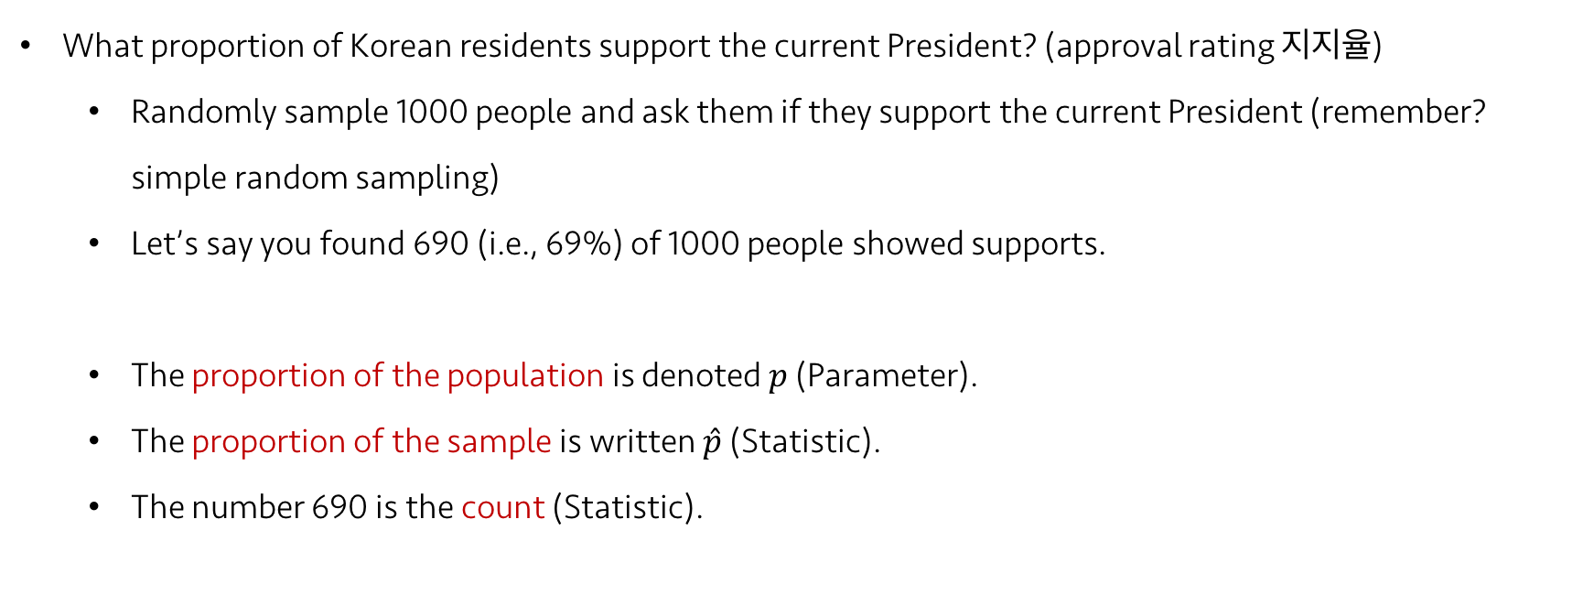
Lecture 14
Sampling distribution of a proportion
What proportion of Korean residents support the current President? (approval rating 지지율)
Randomly sample 1000 people and ask them if they support the current President (remember? simple random sampling)
Let’s say you found 690 (i.e., 69%) of 1000 people showed supports.
The proportion of the population is denoted $p$ (Parameter).
The proportion of the sample is written $\hat{p}$ (Statistic).
The number 690 is the count (Statistic).
CHOONG-WAN WOO | COCOAN lab | http://cocoanlab.github.io

Slide 9
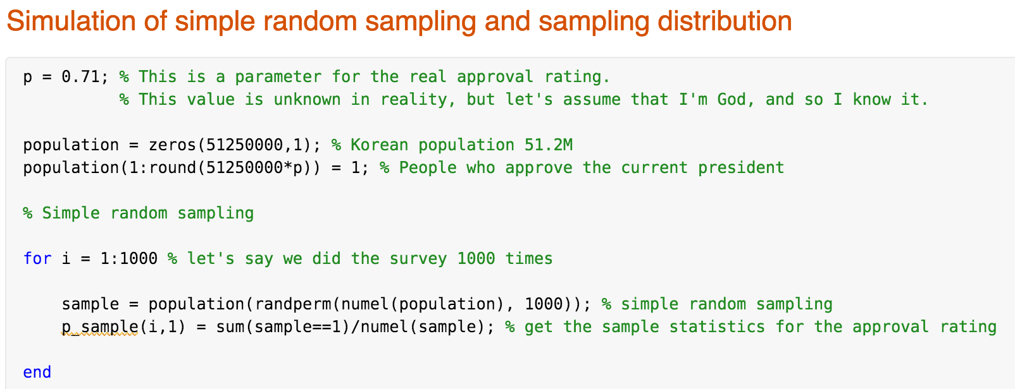
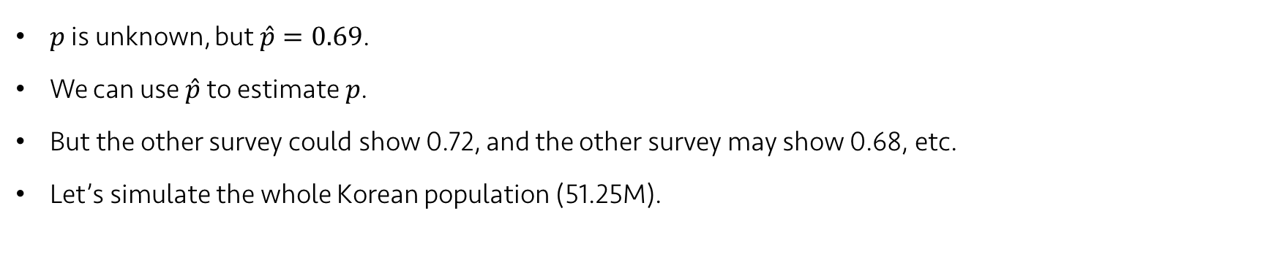
Lecture 14
Sampling distribution of a proportion
$p$ is unknown, but $\hat{p}=0.69$.
We can use $\hat{p}$ to estimate $p$.
But the other survey could show 0.72, and the other survey may show 0.68, etc.
Let’s simulate the whole Korean population (51.25M).
CHOONG-WAN WOO | COCOAN lab | http://cocoanlab.github.io

Slide 10
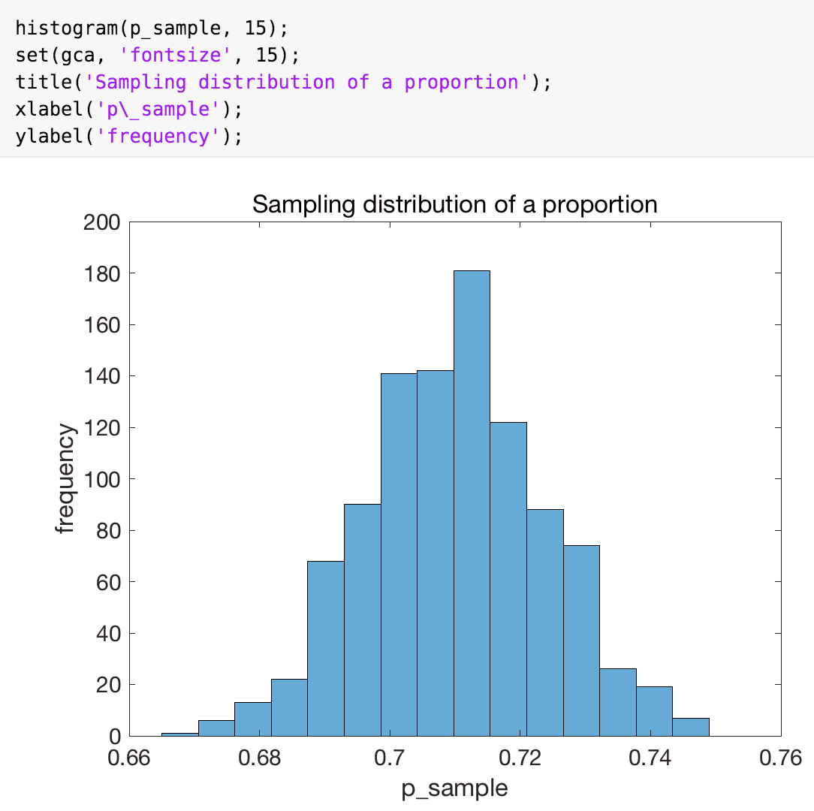
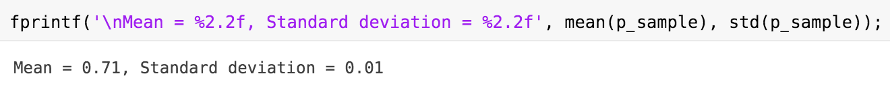
Lecture 14
Sampling distribution of a proportion
This is a “sampling distribution”.
This is different from the sample distribution, which refers to the distribution of the sample, a display of the actual data.
CHOONG-WAN WOO | COCOAN lab | http://cocoanlab.github.io

Slide 11
Lecture 14
Sampling distribution of a proportion
In practice, we only sample the population once. However, we want to understand what would happen if we sampled the population repeatedly.
We want to know what values the statistic can take and how often it takes them, i.e. we want to know the distribution of the statistic.
This will give us an indication of how well a statistic estimates a parameter.
The sampling distribution of a statistic is the distribution of its value in all possible samples of the same size from the same population.
We use mathematical models (e.g. the normal model) to understand the sampling distribution.
We say a statistic (used to estimate a parameter) is unbiased when the mean of its sampling distribution is equal to the true value of the parameter.
CHOONG-WAN WOO | COCOAN lab | http://cocoanlab.github.io

Slide 12
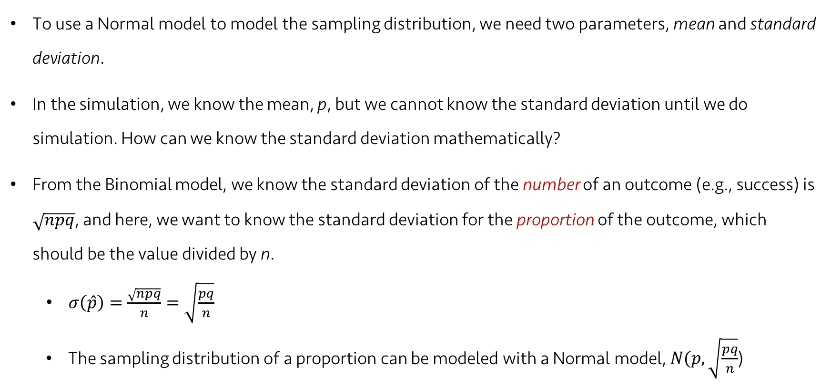
Lecture 14
Sampling distribution of a proportion: Normal model
To use a Normal model to model the sampling distribution, we need two parameters, mean and standard deviation.
In the simulation, we know the mean, p, but we cannot know the standard deviation until we do simulation. How can we know the standard deviation mathematically?
From the Binomial model, we know the standard deviation of the number of an outcome (e.g., success) is $\sqrt{npq}$, and here, we want to know the standard deviation for the proportion of the outcome, which should be the value divided by n.
$σ\left(\hat{p}\right)=\frac{\sqrt{npq}}{n}=\sqrt{\frac{pq}{n}}$
The sampling distribution of a proportion can be modeled with a Normal model, $N(p,\sqrt{\frac{pq}{n}}$)
CHOONG-WAN WOO | COCOAN lab | http://cocoanlab.github.io

Slide 13
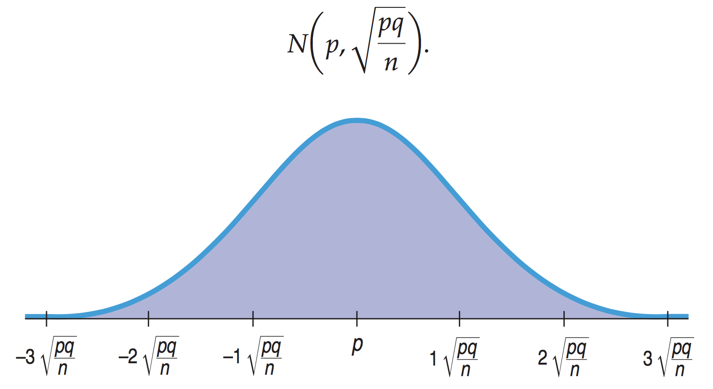
Lecture 14
Sampling distribution of a proportion: Normal model
In our simulation, p = .71, n = 1000, SD = $\sqrt{\frac{0.71 × (1−0.71)}{1000}}$= 0.0143
CHOONG-WAN WOO | COCOAN lab | http://cocoanlab.github.io

Slide 14
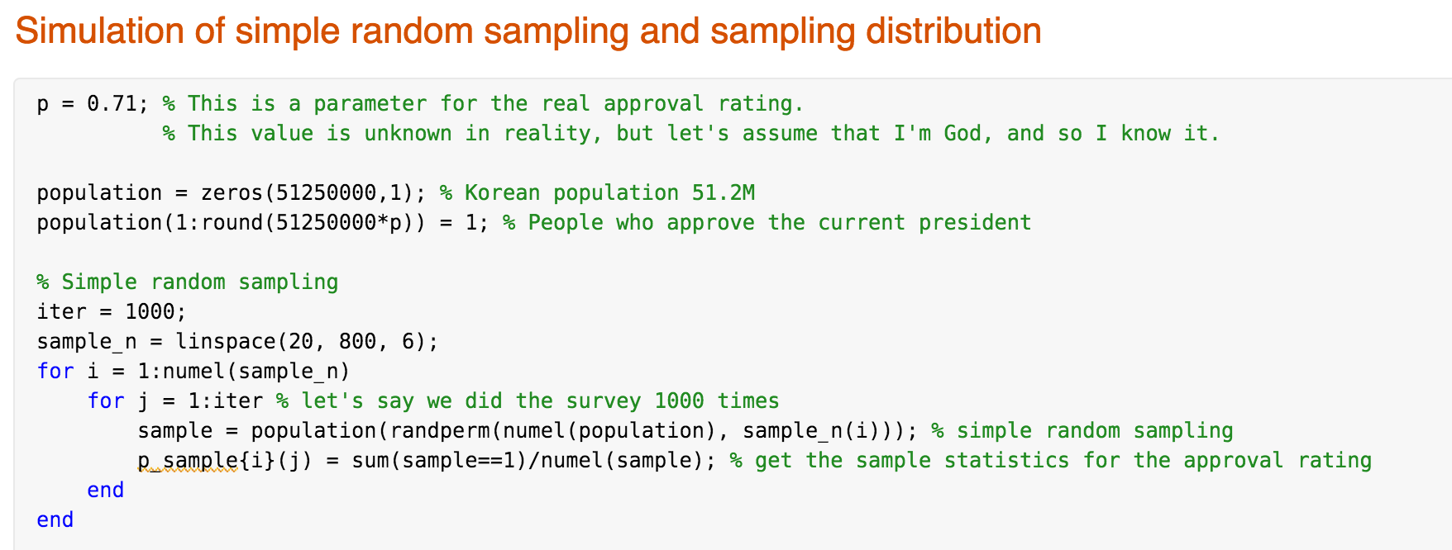
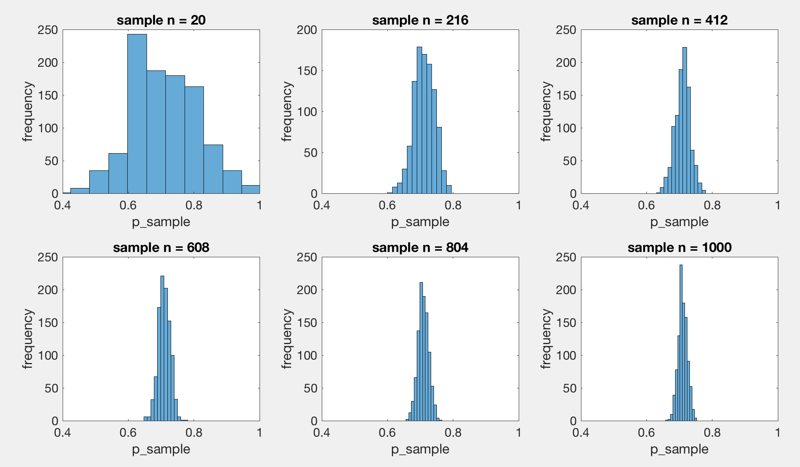
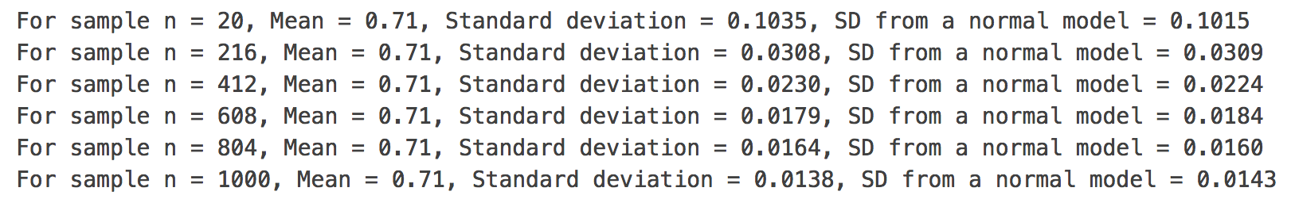
Lecture 14
Sampling distribution of a proportion: Normal model
CHOONG-WAN WOO | COCOAN lab | http://cocoanlab.github.io

Slide 15
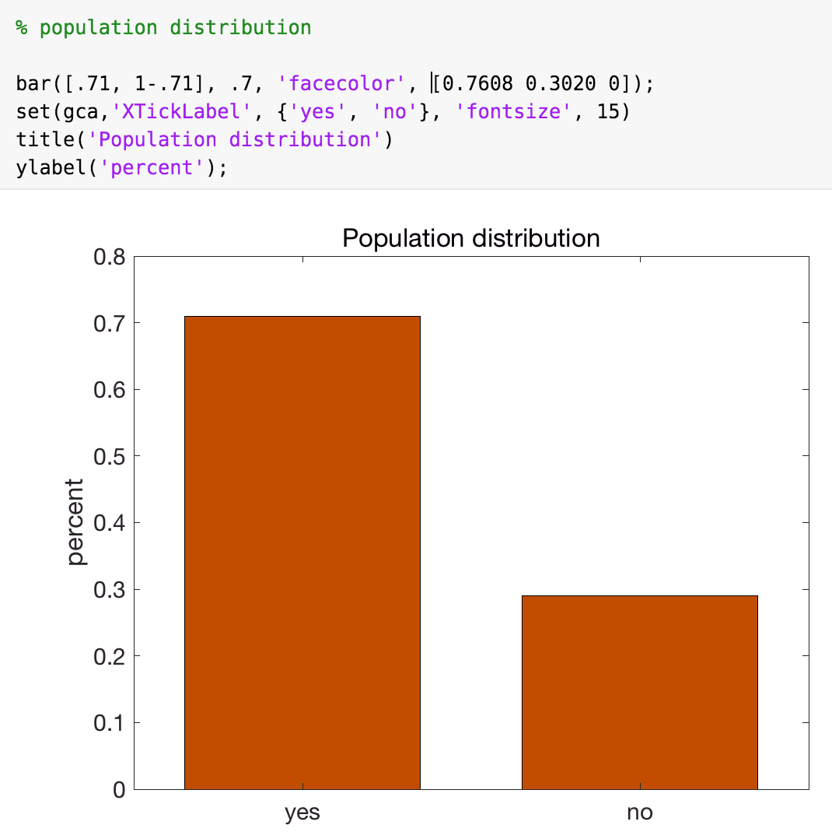
Lecture 14
Population distribution
The population distribution is the probability model derived from information on all members of the population.
Any individual chosen at random from this population will follow the same probability model.
In the example of approval rating, the population distribution is the distribution of Yes’s and No’s in the population, and is described by the parameter p.
CHOONG-WAN WOO | COCOAN lab | http://cocoanlab.github.io

Slide 16
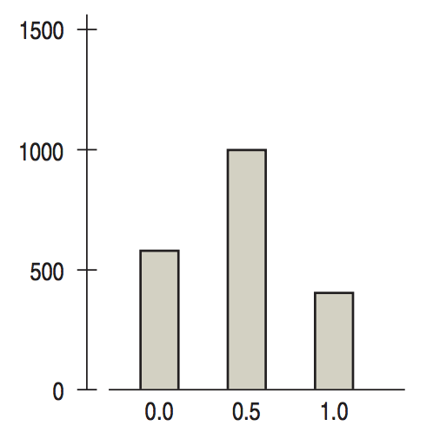
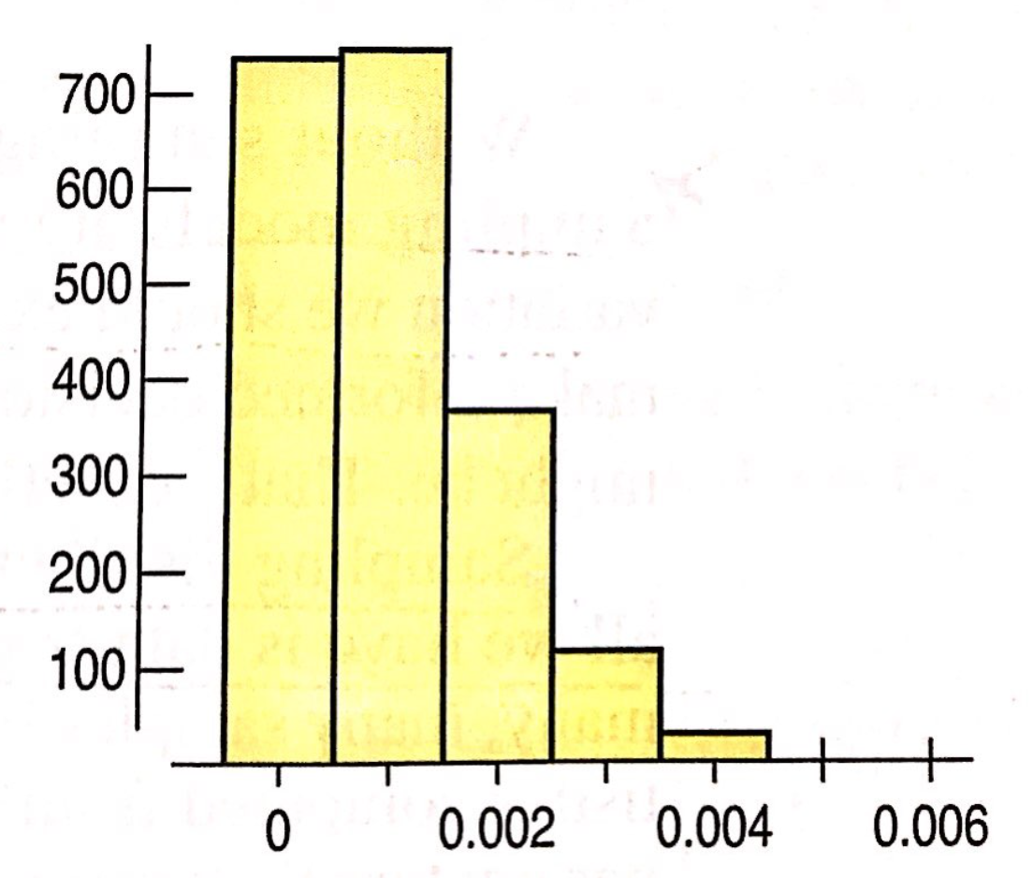
Lecture 14
When does the Normal model work for sampling distribution of a proportion?
Sampling distribution
with sample size n = 2
Sampling distribution when p = 0.001
with sample size n = 1000
CHOONG-WAN WOO | COCOAN lab | http://cocoanlab.github.io

Slide 17
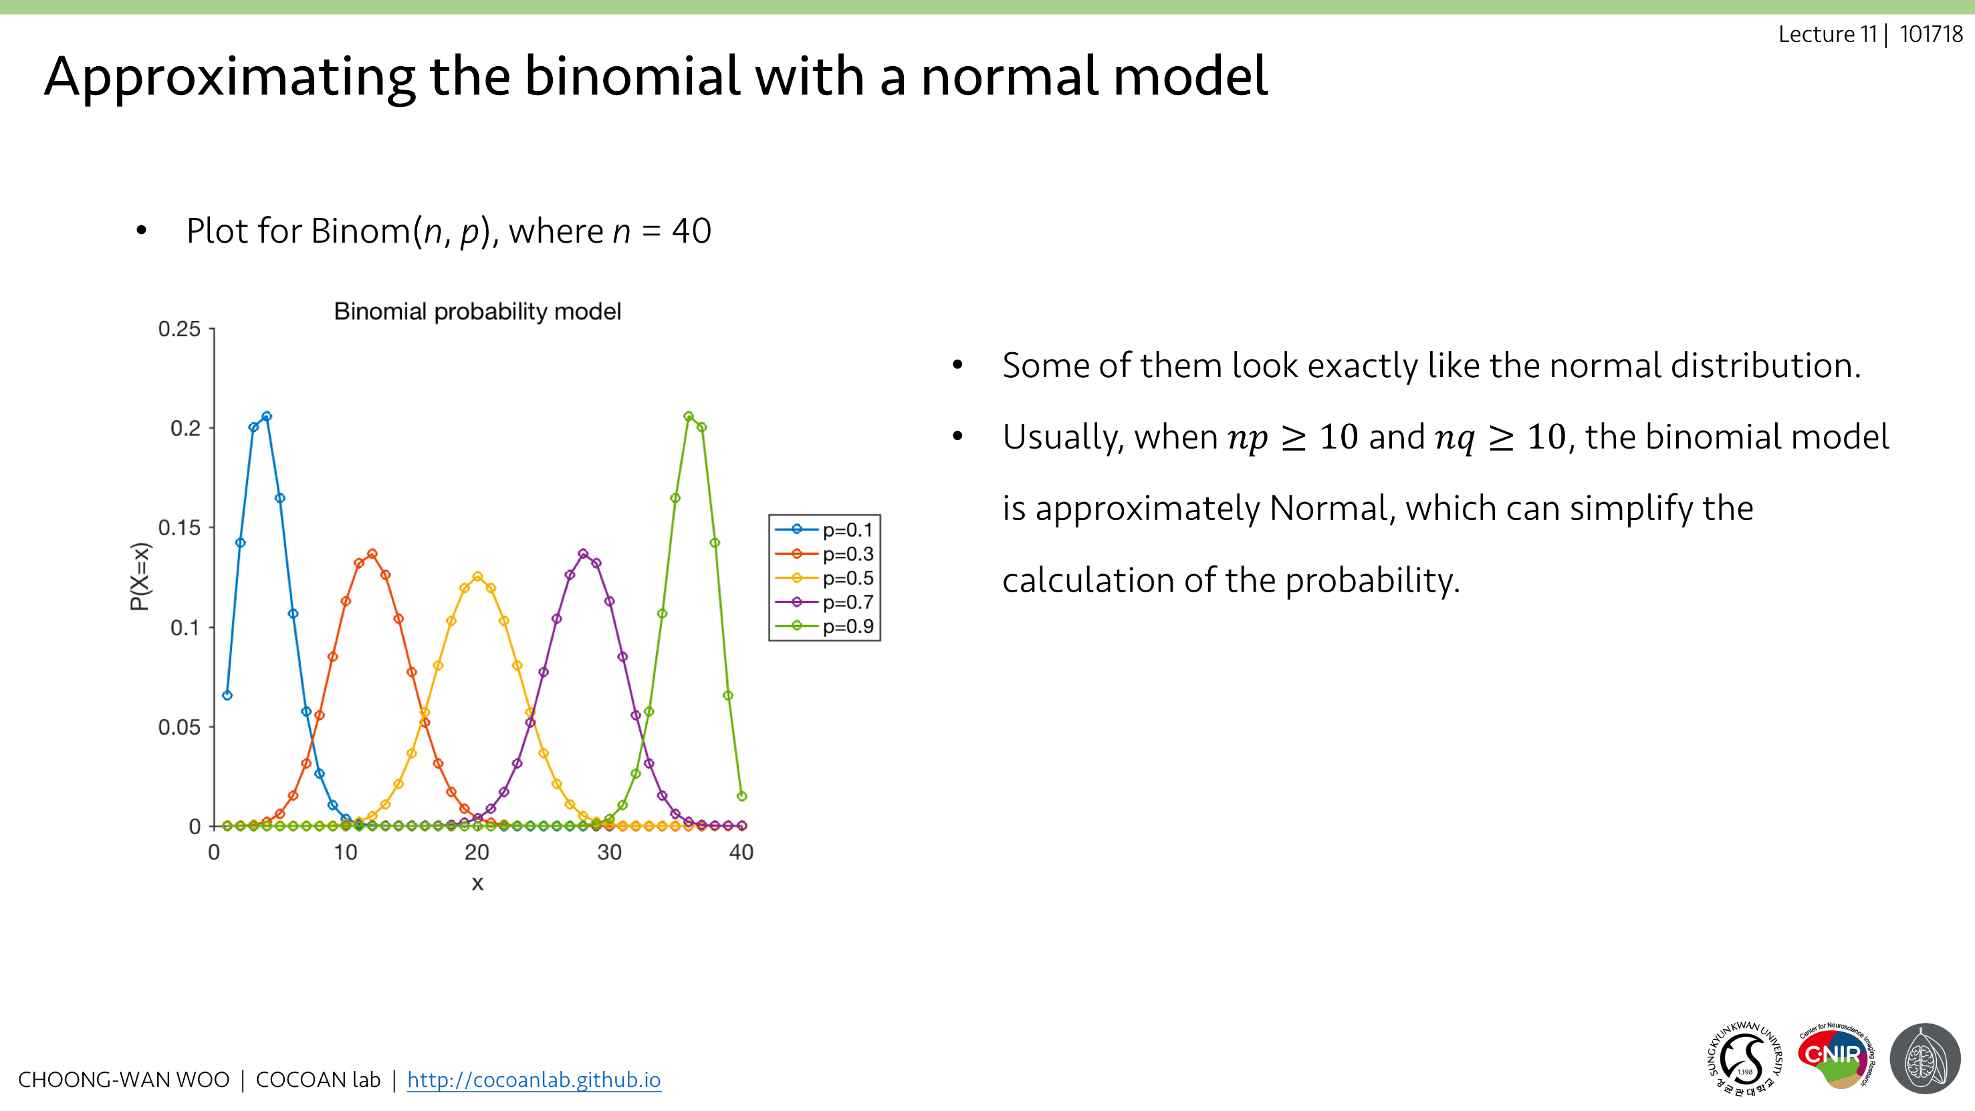
Lecture 14
When does the Normal model work for sampling distribution of a proportion?
Remember…
CHOONG-WAN WOO | COCOAN lab | http://cocoanlab.github.io

Slide 18
Lecture 14
Assumptions and Conditions
Independence Assumption: The individuals in the samples must be independent of each other.
We can’t know if this assumption is true or not for sure, but we can check the following conditions that provide information about the assumption.
Conditions:
Randomization Condition: random assignment (experiment), random sampling (survey)
10% Condition: The sample size, n, must be no larger than 10% of the population. If you sample more than about 10% of the population, the remaining individuals are no longer truly independent of each other. The sampling distribution will have a smaller standard deviation.
Success/Failure Condition: The sample size has to be big enough so that we expect at least 10 successes and at least 10 failures (np and nq should be > 10)
CHOONG-WAN WOO | COCOAN lab | http://cocoanlab.github.io

Slide 19
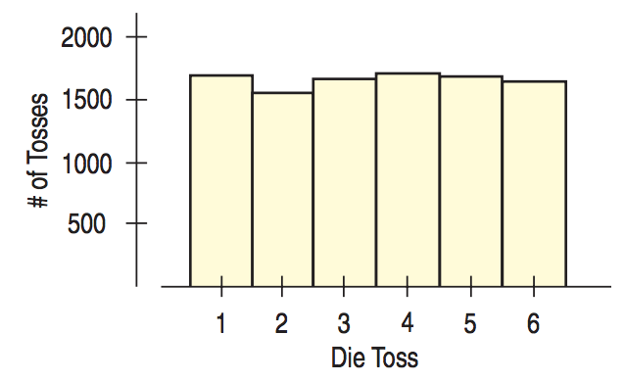
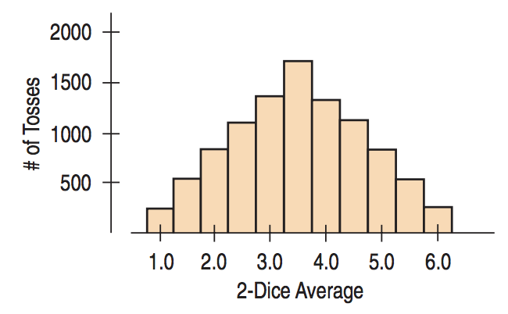
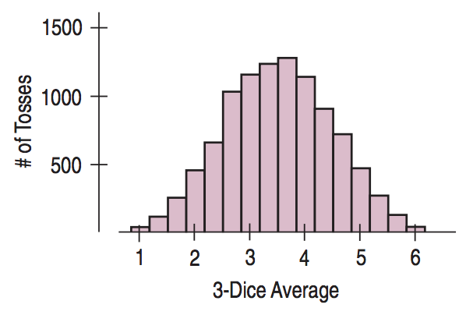
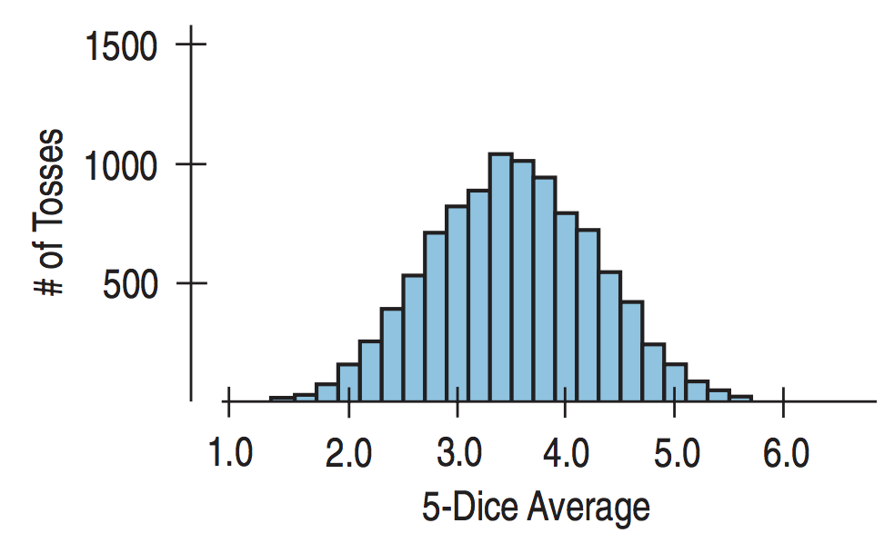
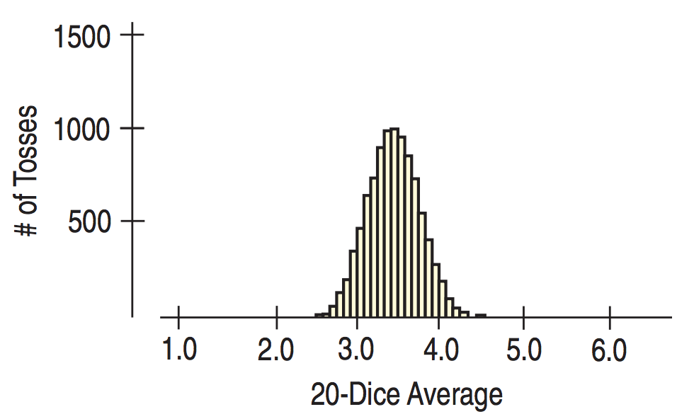
Lecture 14
Sampling distribution of a Mean
A simple simulation: If we toss one fair die 10,000 times, what should the histogram of the numbers on the face of the die look like?
CHOONG-WAN WOO | COCOAN lab | http://cocoanlab.github.io

Slide 20
Lecture 14
Sampling distribution of a Mean
A simple simulation: If we toss one fair die 10,000 times, what should the histogram of the numbers on the face of the die look like?
Sample size (=number of dice) gets larger, each sample average is more likely to be close to the population mean.
And we see the Normal shape clearly, and the spread becomes smaller.
CHOONG-WAN WOO | COCOAN lab | http://cocoanlab.github.io

Slide 21
Lecture 14
Central Limit Theorem
What we saw with dice simulation is true for means for repeated samples for almost every situation.
Central Limit Theorem:
Definition: The mean of a random sample is a random variable whose sampling distribution can be approximated by a Normal model. The larger the sample, the better the approximation will be.
Only assumption: the independence assumption
This works no matter how the data are distributed.
This is proved by Pierre-Simon Laplace in 1810
This is one of the most fundamental theorem of Statistics.
CHOONG-WAN WOO | COCOAN lab | http://cocoanlab.github.io

Slide 22
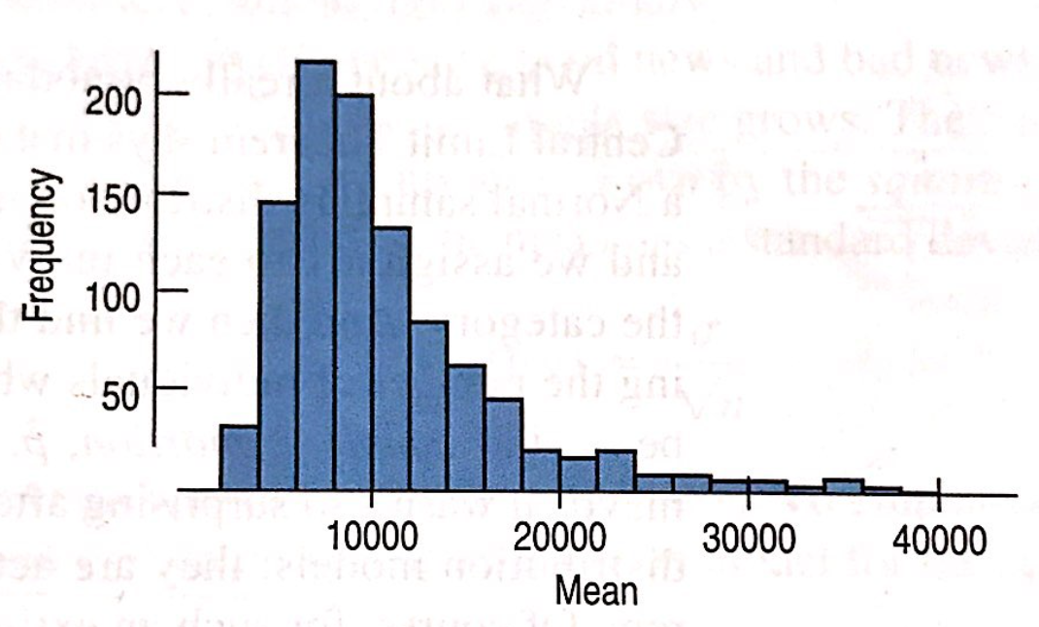
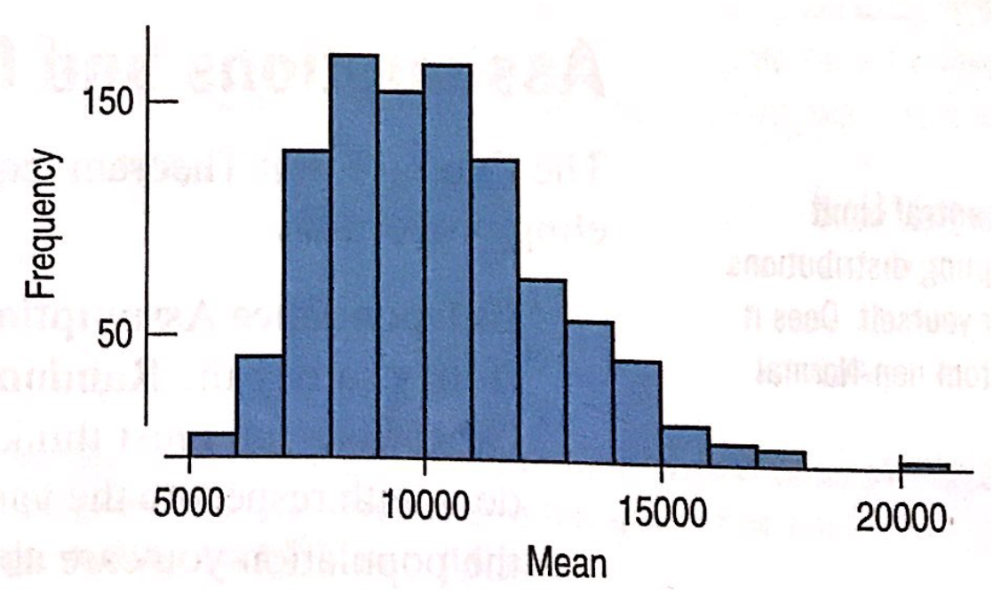
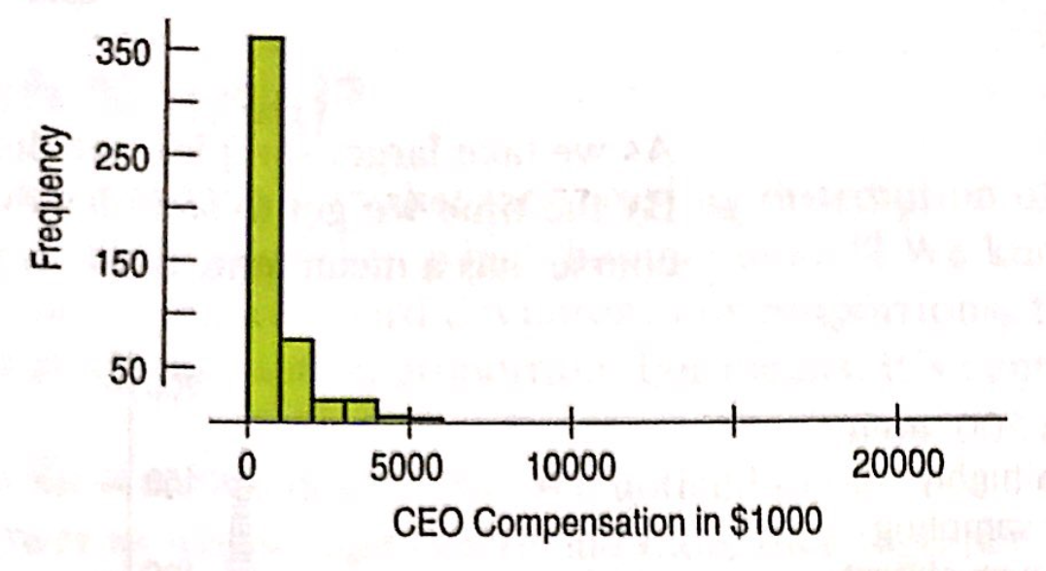
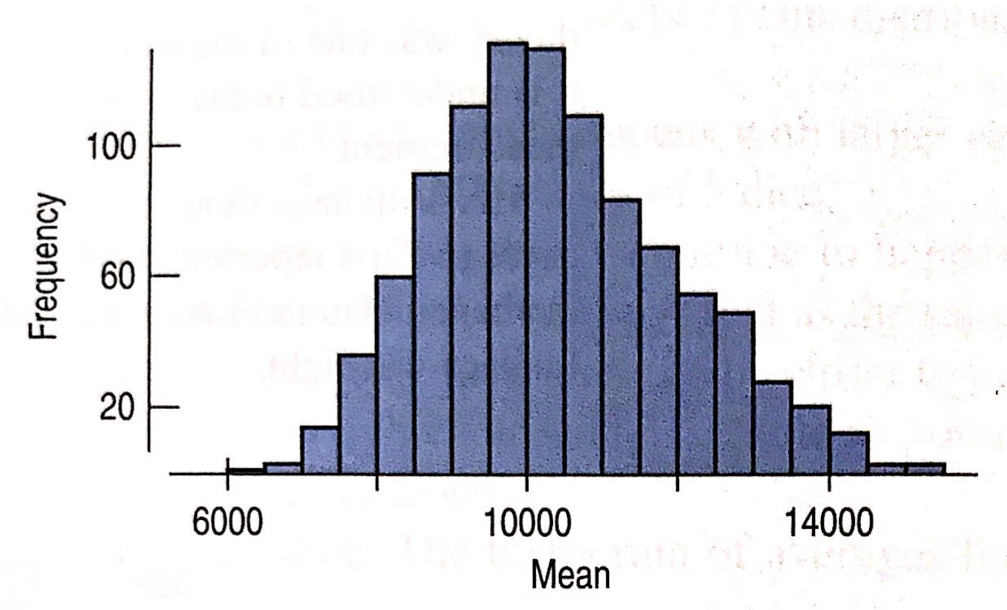
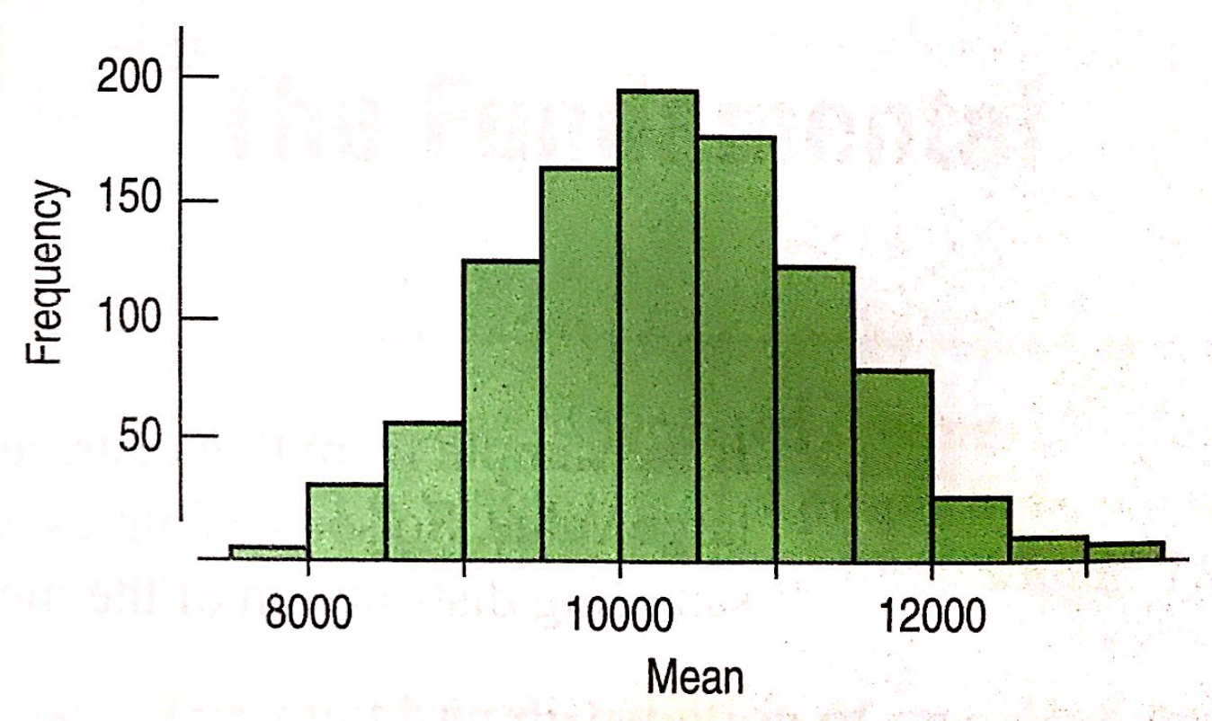
Lecture 14
Central Limit Theorem
Important fact: it works regardless of the shape of the population distribution! Even if we sample from a skewed or bimodal population...
Example: the CEO compensation data:
Original data distribution
(sample distribution)
1000 samples with n = 10
(sampling distribution)
n = 50
n = 100
n = 200
CHOONG-WAN WOO | COCOAN lab | http://cocoanlab.github.io

Slide 23
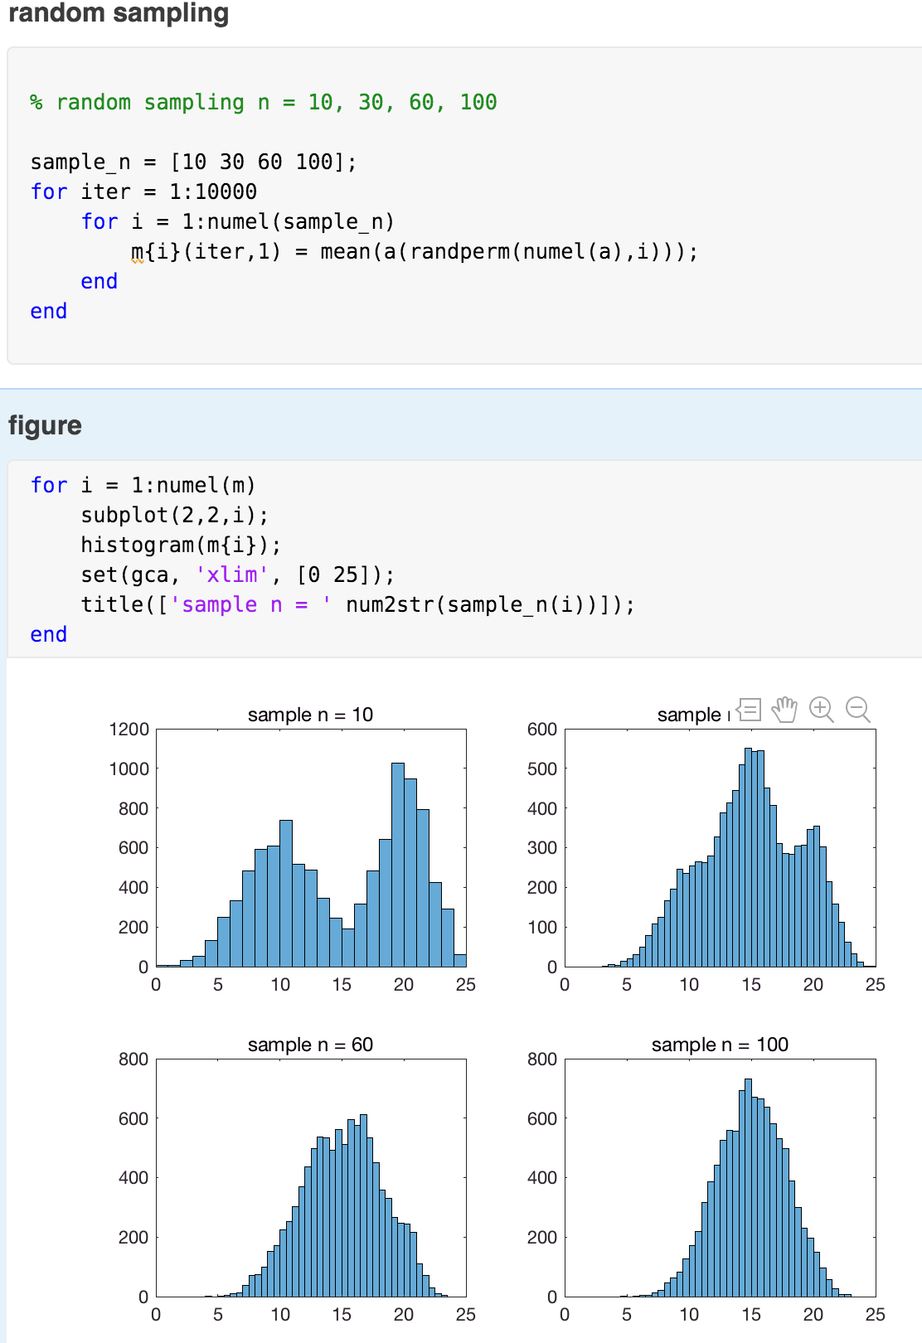
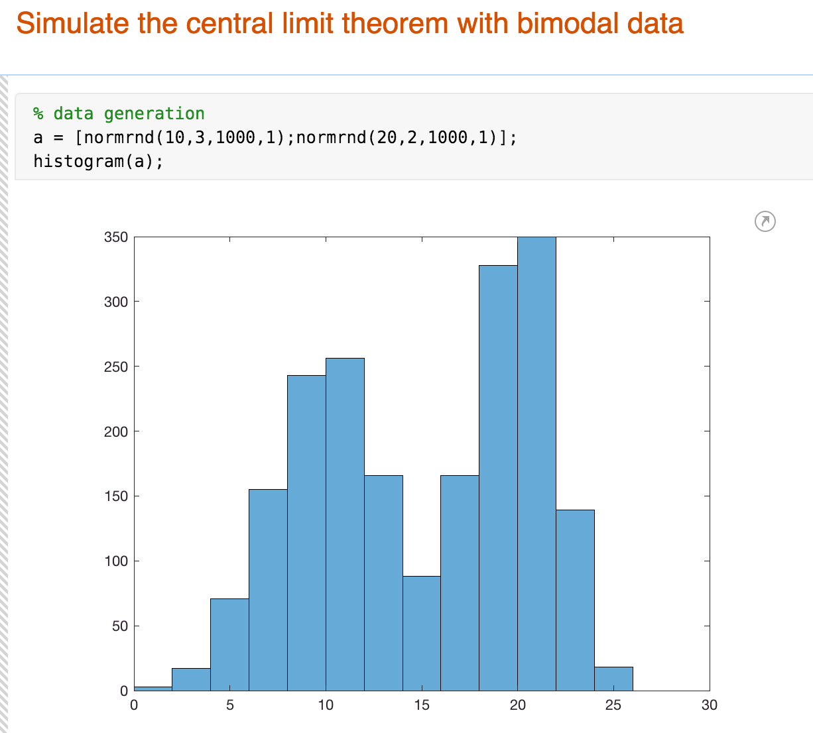
Lecture 14
Central Limit Theorem
Important fact: it works regardless of the shape of the population distribution! Even if we sample from a skewed or bimodal population...
Example: bimodal distribution
CHOONG-WAN WOO | COCOAN lab | http://cocoanlab.github.io

Slide 24
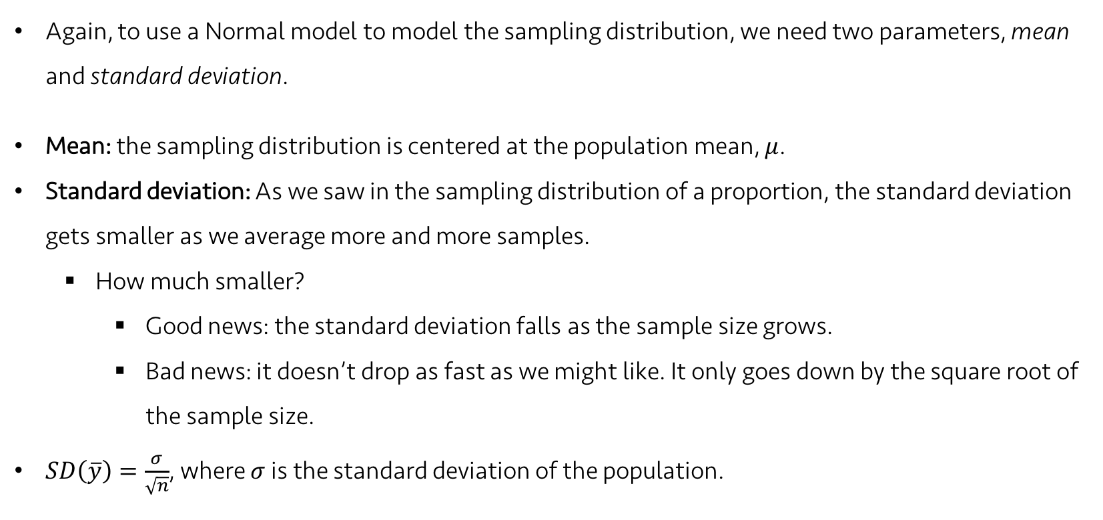
Lecture 14
Which Normal?
Again, to use a Normal model to model the sampling distribution, we need two parameters, mean and standard deviation.
Mean: the sampling distribution is centered at the population mean, $μ$.
Standard deviation: As we saw in the sampling distribution of a proportion, the standard deviation gets smaller as we average more and more samples.
How much smaller?
Good news: the standard deviation falls as the sample size grows.
Bad news: it doesn’t drop as fast as we might like. It only goes down by the square root of the sample size.
$SD\left(\overline{y}\right)=\frac{σ}{\sqrt{n}}$, where $σ$ is the standard deviation of the population.
CHOONG-WAN WOO | COCOAN lab | http://cocoanlab.github.io

Slide 25
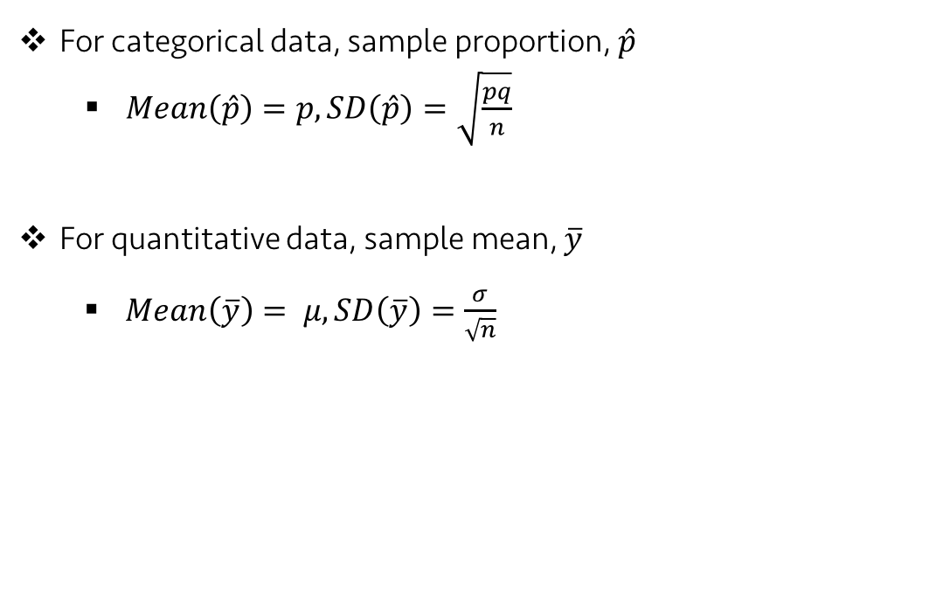
Lecture 14
Review: Which Normal?
For categorical data, sample proportion, $\hat{p}$
$Mean\left(\hat{p}\right)=p, SD\left(\hat{p}\right)=\sqrt{\frac{pq}{n}}$
For quantitative data, sample mean, $\overline{y}$
$Mean\left(\overline{y}\right)= μ, SD\left(\overline{y}\right)=\frac{σ}{\sqrt{n}}$
CHOONG-WAN WOO | COCOAN lab | http://cocoanlab.github.io

Slide 26
Lecture 14
Let’s summarize:
The statistic itself is a random variable.
A different random sample would have given a different statistic results.
This sample-to-sample variability is what generates the sampling distribution.
Fortunately, for the mean and the proportion, the Central Limit Theorem tells us that we can model their sampling distribution directly with a Normal model.
CHOONG-WAN WOO | COCOAN lab | http://cocoanlab.github.io

Slide 27
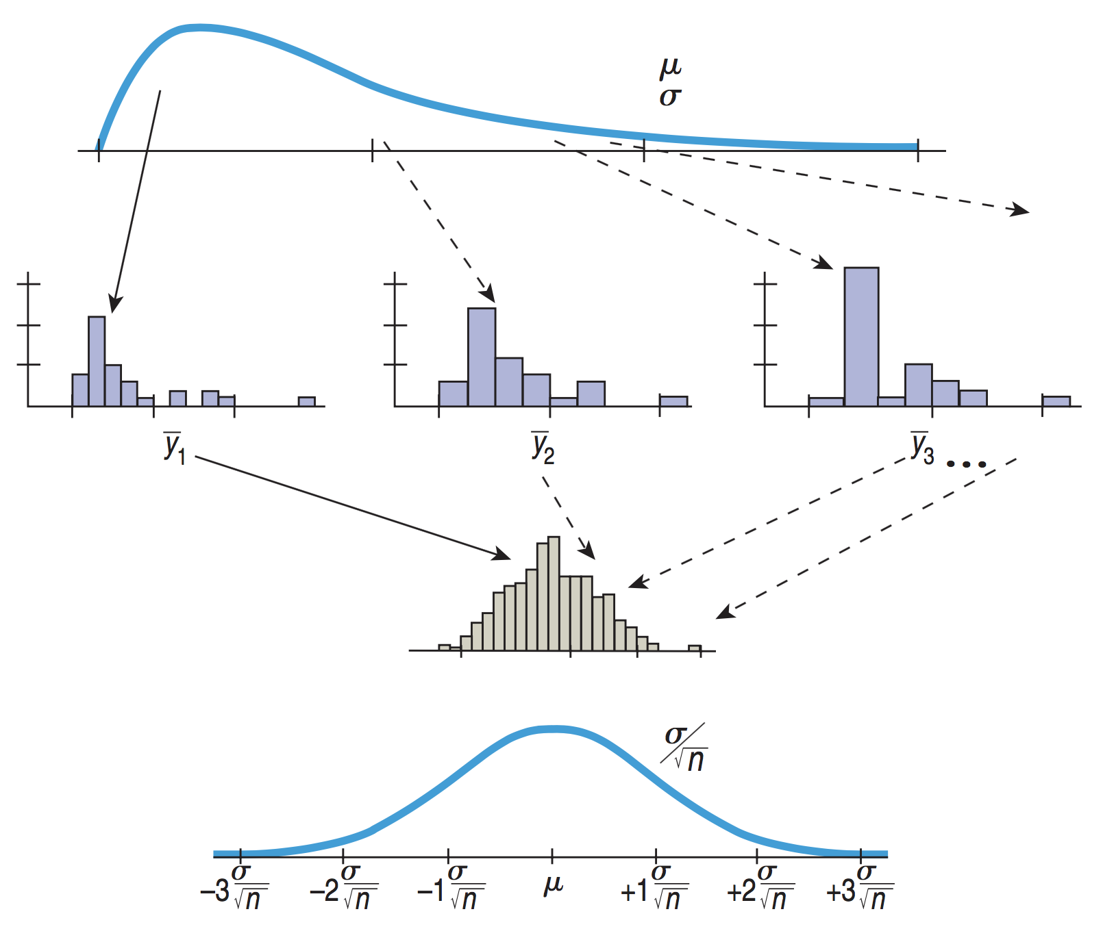
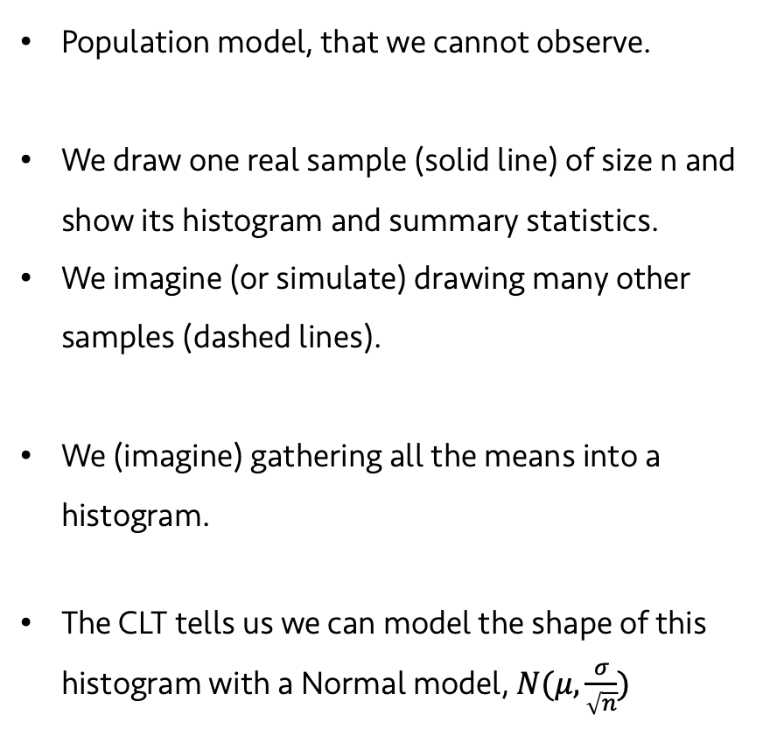
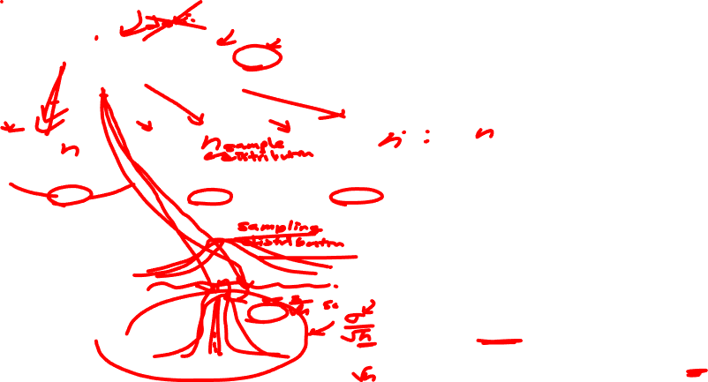
Lecture 14
Let’s summarize:
Population model, that we cannot observe.
We draw one real sample (solid line) of size n and show its histogram and summary statistics.
We imagine (or simulate) drawing many other samples (dashed lines).
We (imagine) gathering all the means into a histogram.
The CLT tells us we can model the shape of this histogram with a Normal model, $N(μ,\frac{σ}{\sqrt{n}})$
CHOONG-WAN WOO | COCOAN lab | http://cocoanlab.github.io

Slide 28
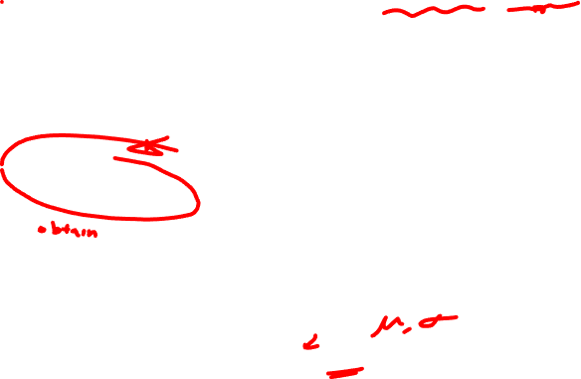
Lecture 14
But… can we actually know the mean and SD of the sampling distribution?
Population model, that we cannot observe.
We draw one real sample (solid line) of size n and show its histogram and summary statistics.
We imagine (or simulate) drawing many other samples (dashed lines).
We (imagine) gathering all the means into a histogram.
The CLT tells us we can model the shape of this histogram with a Normal model, $N(μ,\frac{σ}{\sqrt{n}})$
No.. Then, what should we do?
To be continued…
CHOONG-WAN WOO | COCOAN lab | http://cocoanlab.github.io

Slide 29
Lecture 14
Quiz 14-3 (3 min)
https://forms.gle/cRVzjx7Gz5tV3hSw7
CHOONG-WAN WOO | COCOAN lab | http://cocoanlab.github.io

Slide 30
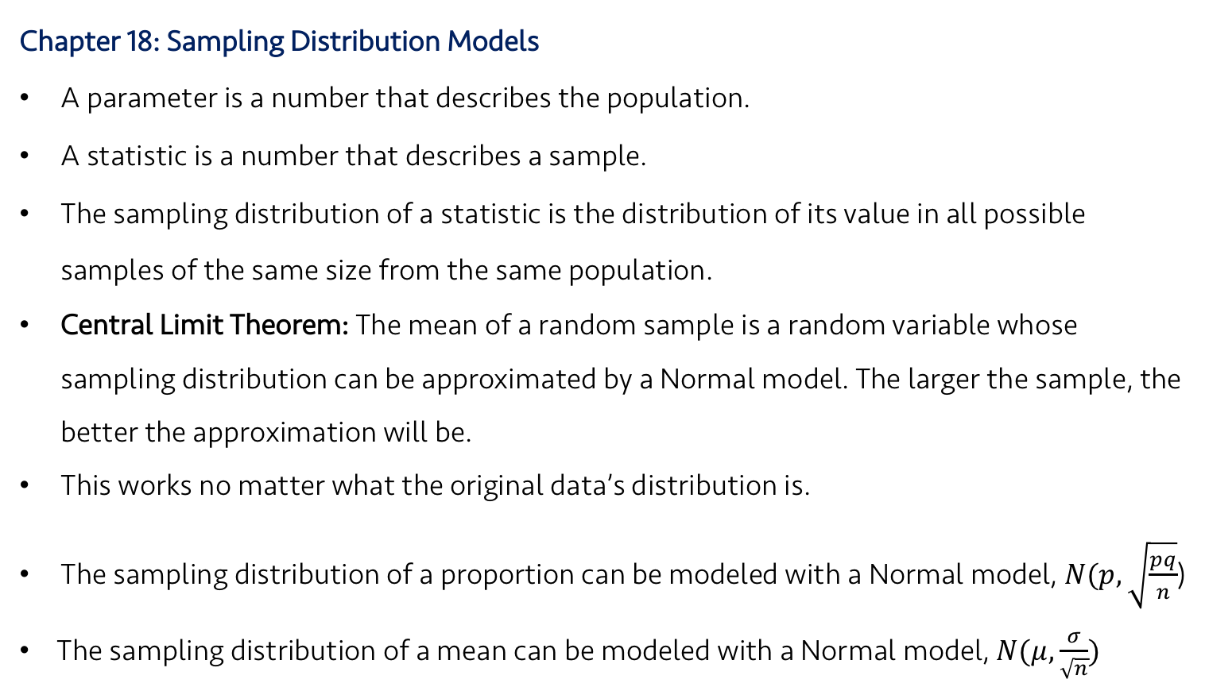
Lecture 14
Key Points
Chapter 18: Sampling Distribution Models
A parameter is a number that describes the population.
A statistic is a number that describes a sample.
The sampling distribution of a statistic is the distribution of its value in all possible samples of the same size from the same population.
Central Limit Theorem: The mean of a random sample is a random variable whose sampling distribution can be approximated by a Normal model. The larger the sample, the better the approximation will be.
This works no matter what the original data’s distribution is.
The sampling distribution of a proportion can be modeled with a Normal model, $N(p,\sqrt{\frac{pq}{n}}$)
The sampling distribution of a mean can be modeled with a Normal model, $N(μ,\frac{σ}{\sqrt{n}})$
CHOONG-WAN WOO | COCOAN lab | http://cocoanlab.github.io

